Slide 1
Hospital Route
By : Leonardo Redhiarto ( A11.2015.08805)

Slide 2
Explanation
Tujuan :
Untuk menentukan rute terdekat menuju ke suatu rumah sakit yang berada dekat dengan lokasi kecelakaan/musibah.

Slide 3
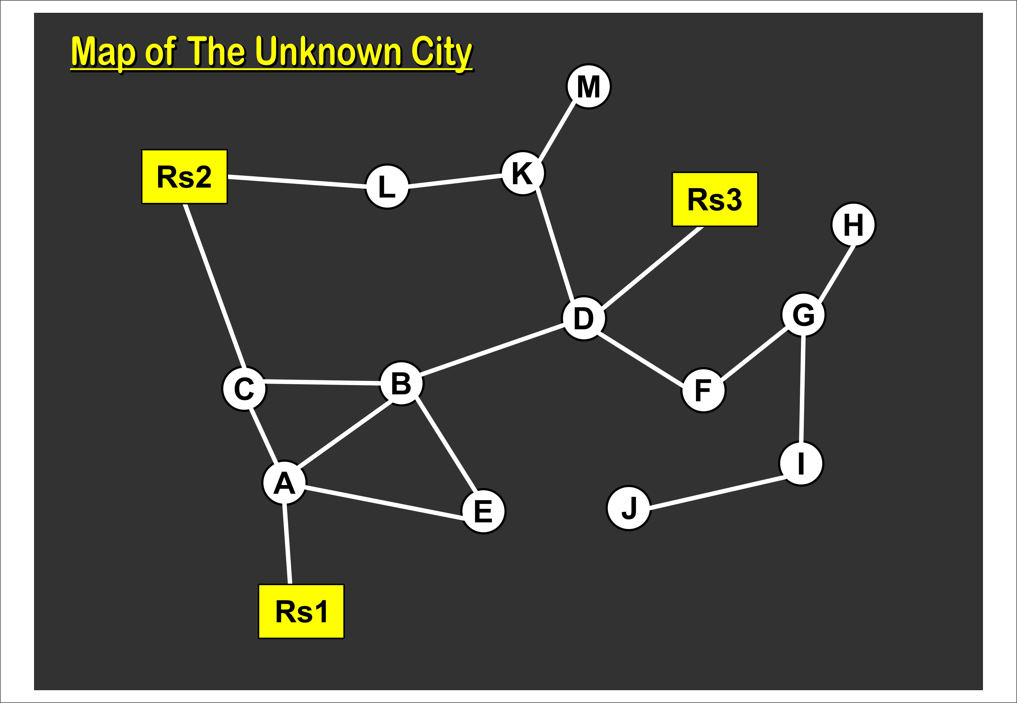
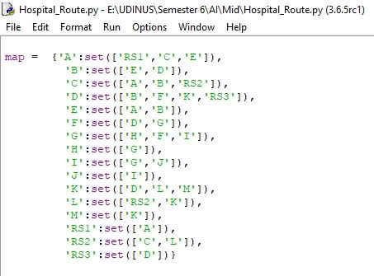
Map
Map’s Code
Map’s Picture (Graph)

Slide 4
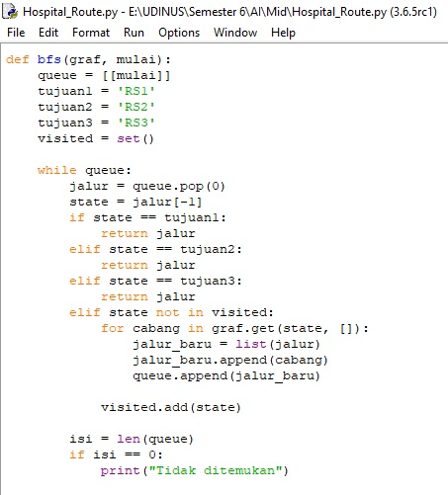
Shortest Route’s Code (Using BFS)
Mengapa BFS?
Karena BFS (Breadth First Search) adalah metode dimana dia akan mengecek seluruh cabang secara bersamaan, hingga ditemukan satu cabang yang paling akurat yang menuju ke hasil pencarian. (Titik akhir cabang).

Slide 5
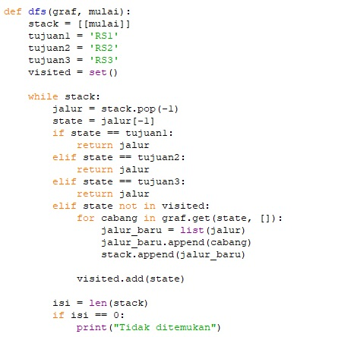
Optional Route’s Code (Using DFS)
Mengapa DFS?
Karena DFS (Deepth First Search) adalah metode dimana dia akan mengecek satu cabang hingga selesai. (Titik akhir cabang).

Slide 6
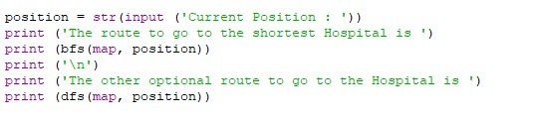
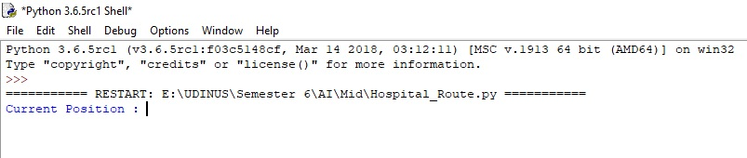
Input Data’s Code
Input Data

Slide 7
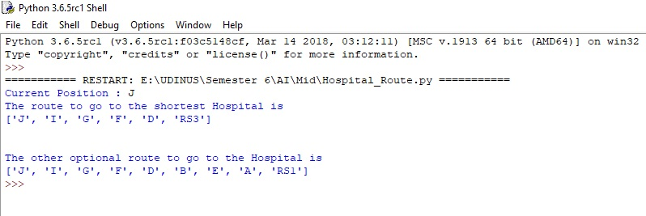
Result
The Shortest Route is = J, I, G, F, D, RS3
One of the Optional Route is = J, I, G, F, D, B, E, A, RS1

Slide 8
Shortest Route
Why (J, I, G, F, D, RS3) ?
Answer :
Start = J
J ; Visited J.
JI ; Visited J I.
JIG ; Visited J I G.
JIGF, JIGH ; Visited J I G F.
JIGFD, JIGH ; Visited J I G F D.
JIGFD(RS3), JIGFDK, JIGFDB, JIGH ; Visited J I G F D RS3.
Conclusion : The “Visited” already reaches ‘RS3’ then it is the route, shortest route. No use to check the other branches.

Slide 9
Optional Route
Why (J, I, G, F, D, B, E, A, RS1) ?
Answer : This is one of the some routes that pointing to a Hospital. (Can be the shortest or the longest).
Start = J
J ; Visited J.
JI ; Visited J I.
JIG ; Visited J I G.
JIGF, JIGH ; Visited J I G H. (Because this is a dead end, we can erase this route)
JIGF ; Visited J I G F.
JIGFD ; Visited J I G F D.
JIGFD(RS3), JIGFDK, JIGFDB ; Visited J I G F D B.
JIGFD(RS3), JIGFDK, JIGFDBC, JIGFDBA, JIGFDBE ; Visited J I G F D B E.
JIGFD(RS3), JIGFDK, JIGFDBC, JIGFDBA, JIGFDBEA ; Visited J I G F D B E A.
JIGFD(RS3), JIGFDK, JIGFDBC, JIGFDBA, JIGFDBEA(RS1) ; Visited J I G F D B E A RS1.

